Slide 1
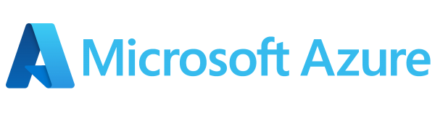
Azure-Based Demand Forecasting & Capacity Optimization System
~A scalable cloud architecture for predictive analysis and automated capacity planning
This presentation outlines a robust workflow designed for advanced demand forecasting and capacity optimization. We will explore components from diverse data sources to intelligent consumption which ensures a seamless solution encouraging efficiency.

Slide 2
Diverse Data Sources
~The foundation of Insight
Our system integrates data from three major sources, giving us both operational and external market visibility.
Snowflake (External Features Dataset):
From Snowflake, we ingest external economic indicators that directly influence cloud usage patterns.
Google Cloud Platform (Feature Engineering Dataset):
In GCP, we maintain our feature engineering dataset, containing enriched historical usage metrics.This dataset is extremely important because it provides the behavioral and technical indicators needed for forecasting
REST API (Demand Data):
We also pull fresh demand data through a REST API hosted on Render.

Slide 3
Efficient Data Ingestion
With Azure Data Factory
Azure Data Factory(ADF) acts as the central nervous system for data ingestion by orchestrating secure and scheduled data transfer from disparate sources into the Azure environment.
ADF connectors
Snowflake Integration
Uses ADF’s native Snowflake connector with Azure Key Vault for secure credentials. Enables automated ingestion of curated datasets like external features into the pipeline.
GCP Connectivity
Connects to Google Cloud using ADF’s GCP connectors and REST-based integrations. Supports data pulls from Cloud Storage, Cloud SQL, and feature-engineering datasets efficiently.
REST API Ingestion (Render API)
Uses ADF’s HTTP Linked Service to call the Render-hosted REST API. Scheduled GET requests bring in operational demand data continuously without manual steps.

Slide 4
Efficient Data Ingestion
With Azure Data Factory
Azure Data Factory(ADF) acts as the central nervous system for data ingestion by orchestrating secure and scheduled data transfer from disparate sources into the Azure environment.
Ingestion Steps
Scheduled Pipelines: Configured for hourly, daily or real-time ingestion based on data critically.
Incremental Extraction: Efficiently extracts new and incremental data to minimize processing overhead.
Raw Data Landing: Lands all raw ingested data directly into the azure Data Lake Storage(ADLS) Bronze layer

Slide 5
Azure Data Lake Storage
~Structured Data lake Storage
Azure Data Lake Storage(ADLS) provides a scalable and secure foundation for our data, organized into distinct layers to support progressive data refinement.
Bronze Layer
Raw, immutable ingested data(JSON, CSV, Parquet). The initial landing zone for all of the incoming information. Data is stored is preserved with full fidelity for reprocessing, auditing and also it’s traceability.

Slide 6
Azure Data Lake Storage
~Structured Data lake Storage
Azure Data Lake Storage(ADLS) provides a scalable and secure foundation for our data, organized into distinct layers to support progressive data refinement.
Silver Layer
Cleaned, filtered, deduplicated and structured data is ready for basic analysis. Standardized schemas and enriched fields are applied to ensure consistency across all downstream analytical processes.

Slide 7
Azure Data Lake Storage
~Structured Data lake Storage
Azure Data Lake Storage(ADLS) provides a scalable and secure foundation for our data, organized into distinct layers to support progressive data refinement.
Gold Layer
Aggregated, ML-ready curated datasets. Optimized for consumption by analytics and machine learning models. Designed to deliver high-value, business-ready insights with optimized forecasting and analytics.

Slide 8
Azure Data Lake Storage
~Structured Data lake Storage
Azure Data Lake Storage(ADLS) provides a scalable and secure foundation for our data, organized into distinct layers to support progressive data refinement.
Bronze Layer
Silver Layer
Gold Layer
Medallion Architecture
ADF automatically writes ingested data into ADLS, partitioned by the date, source and type with metadata captured for governance.

Slide 9

Intelligent Data Processing
With Azure Databricks
Azure databricks is the powerhouse for transforming raw data into actionable insights by utilizing powerful PySpark/SQL notebooks and Delta Live Tables.
Transformation Pipelines
Bronze -> Silver: Comprehensive data cleaning, missing value handling, type conversions and normalization
Silver -> Gold: Advanced feature engineering, time-series aggregation(daily/weekly/monthly), lag features, moving averages and capacity metrics calculation.
Databricks Delta Lake
Ensures ACID(Atomicity, Consistency, Isolation, Durability) transactions for reliable data operations.
Provides an efficient storage format specifically optimized for machine learning workloads.

Slide 10
Machine Learning: Forecasting & Optimization
Azure Databricks powers the core forecasting engine by processing curated Gold-layer datasets and applying advanced machine-learning techniques for accurate, region-wise demand prediction.
Model Development
We build and evaluate multiple forecasting models—including ARIMA, Prophet, XGBoost, and LSTM—using Databricks notebooks. Each model is trained on enriched demand data with lag features, moving averages, seasonal indicators, and macro-economic inputs from Snowflake and GCP.
Capacity Optimization
Optimization logic is integrated directly within Databricks, using statistical trend analysis and rule-based allocation strategies to evaluate compute vs storage demand patterns and recommend optimal resource planning.
Model Storage & Deployment
All forecast outputs and model comparison results are written back to the Gold layer in Delta format, registered through MLflow for tracking, and consumed by Power BI dashboards for real-time analytics and decision support

Slide 11


Serving Layer: Delivering Insights
The serving layer ensures that the intelligence generated by our ML models is accessible and actionable through real-time APIs, interactive dashboards and conversational interfaces.
Real-Time Prediction APIs
Deliver instant demand forecasts, capacity needs and the recommended actions to integrate systems.
PowerBI Dashboards
Interactive dashboards visualize forecast trends, capacity vs. demand, resource utilization and facilitation of what-if analysis.

Slide 12
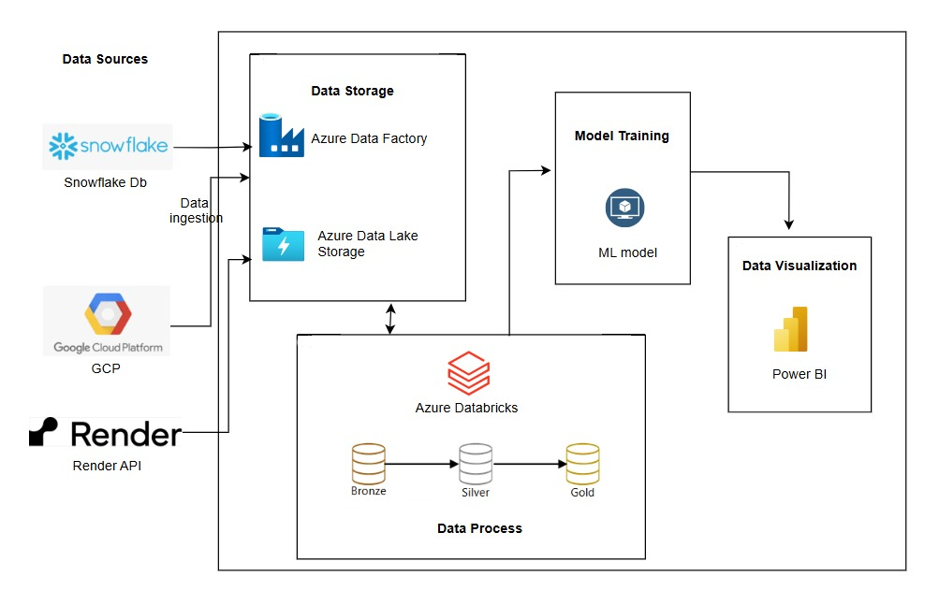
Architecture

Slide 13
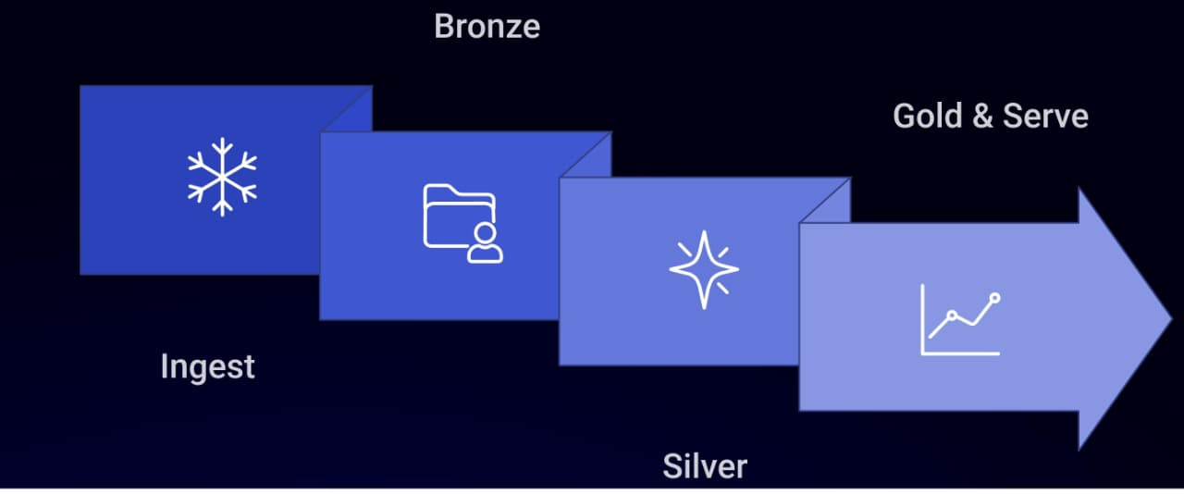
End-to-End Workflow Summary
From Data to Decision
This automated and robust pipeline ensures continuous data flow, processing and actionable insights, driving smarter business decisions.
The entire system operates on scheduled, automated pipelines by minimizing manual intervention and maximizing efficiency.

Slide 14
Key Benefits
Transforming Operations with Predictive Power
Enhanced Accuracy
Leverage advanced ML models for highly accurate demand forecasts.
Optimized Capacity
Proactively manage resources and prevent bottlenecks
Cost Reduction
Minimize waste and over-provisioning through precise planning.
Agile Decision-Making
Gain real-time insights for responsive operational adjustments.

